Slide 1
ALZHEIMER CARE
Name- Sheetal Singh
NUID- 001672346.
Presented By- SHEETAL SINGH
NUID- 001617783

Slide 2
Problem Statement
The basic thought behind this idea is to help Alzheimer patients to live a better and smoother life.
The idea is to build an application where the patient will be assigned a caretaker. The caretaker will keep track of the patient medications and well-being.

Slide 3
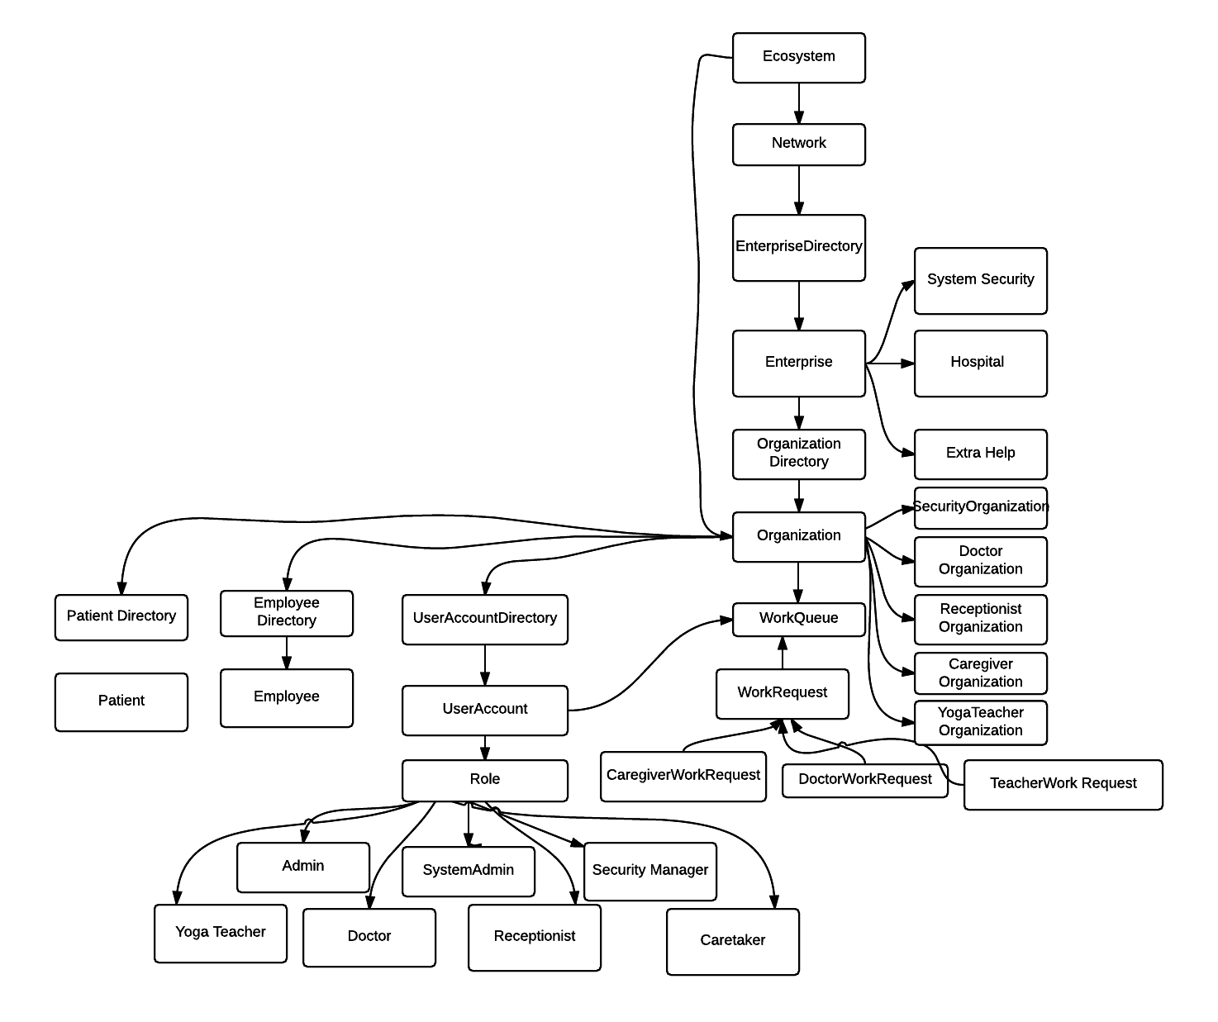
ECOSYSTEM MODEL

Slide 4
WORK FLOW
RECEPTIONIST
PLAY MUSIC,ETC
DOCTOR
YOGA TEACHER
SECURITY MANAGER
SHOW VIDEO
CAREGIVER

Slide 5
Work Requests
Receptionist at the hospital logs in into the system. A patient comes up. Add the patient for checkup and send request to the doctor.
Doctor receives the request sent by Receptionist. Doctor first assigns the project to himself/herself and then processes the request.
The doctor checks the patient and inform the Receptionist about the behavioural problems and also next checkup date.

Slide 6
Work Requests …contd
Receptionist can see the patient behavioural problems as well as other details.
Doctor can view all the requests raised for various patients
Doctors then have an option of sending the patient request to the caregiver for further care. Doctor pass the request to Caregiver Department.
Caregiver when logs in can see list of request from the doctor. He / She assigns the patient to him/her self and process the patient’s request .

Slide 7
Work Requests …contd
Caregiver further decides what treatment a patient has to be given on the basis of behavioural problems.
Caregiver can provide him various treatments like Creating routine report, displaying their family pictures, play music and even assign them to Yoga teacher as per behavioural problem.
Yoga Teacher can see the list of requests from caretaker and assign the request to himself and provide schedule for the patient.

Slide 8
Work Requests …contd
SystemSecurity Manager role to maintain the security of overall application, so that the data is not visible to unauthorized clients.

Slide 9
Reference
http://ecaregivers.com/2015/10/every-caregiver-should-know-these-tips-for-dealing-with-difficult-behaviors-in-alzheimers/
http://www.caregiverslibrary.org/caregivers-resources/grp-diseases/hsgrp-alzheimers-disease/dealing-with-aggressive-behavior-article.aspx
http://www.alzheimersblog.org/2013/08/19/alzheimers-caregiving-theres-app-that/

